Slide 1
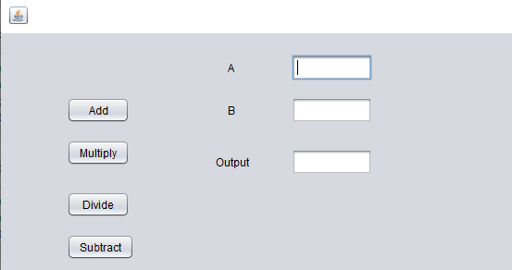
How to Develop A Simple GUI Application: Calculator
Create a class, instance variables, and button handlers for the following GUI application. ‘A’ and
‘B’ are integer variables. When any one of the buttons like “Add”, “Multiply”, “Divide”, and
“Subtract” are clicked, the result of binary operation on “A” and “B” is displayed in the output
textfield.
Figure#0, GUI of the Calculator Application

Slide 2
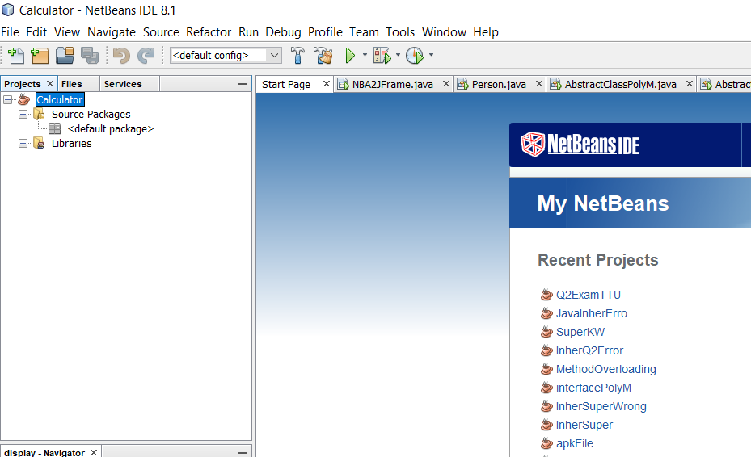
Creating Calculator Application
Figure#1 NetBeans Project Created

Slide 3
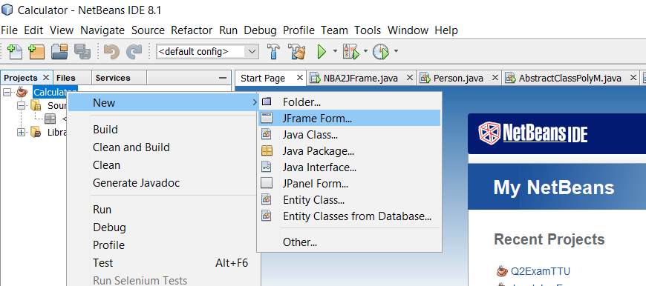
Creating A Frame Class for Application
Figure#2, Creating a Frame Class For the Application

Slide 4
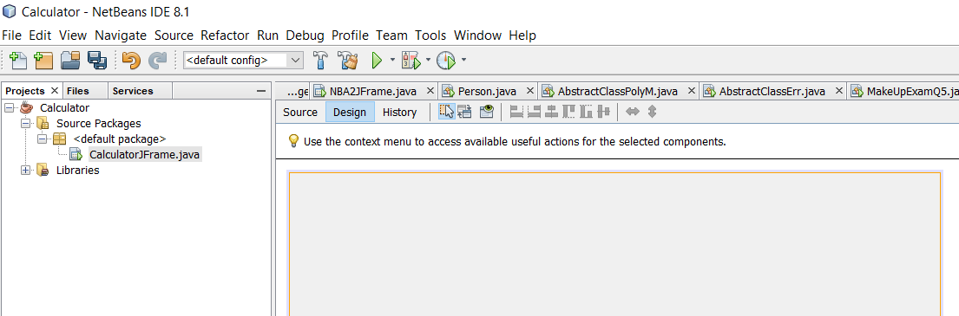
First Run of Application with Empty Frame
Figure#3, Output of Application with Empty Frame

Slide 5
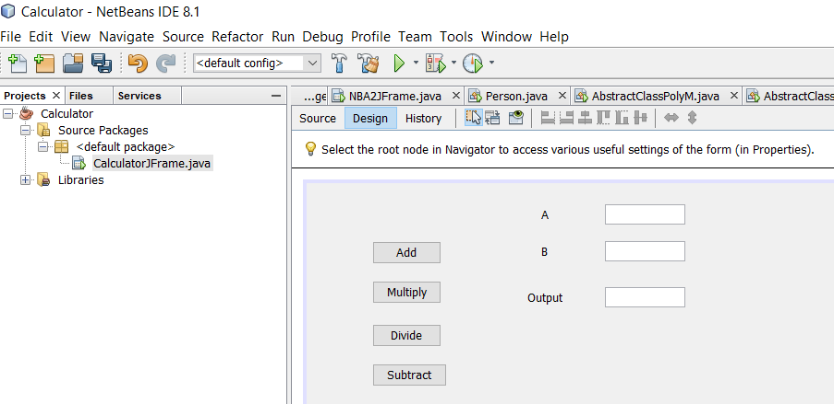
Creating GUI of Application
Figure#4, Creating GUI of Application

Slide 6
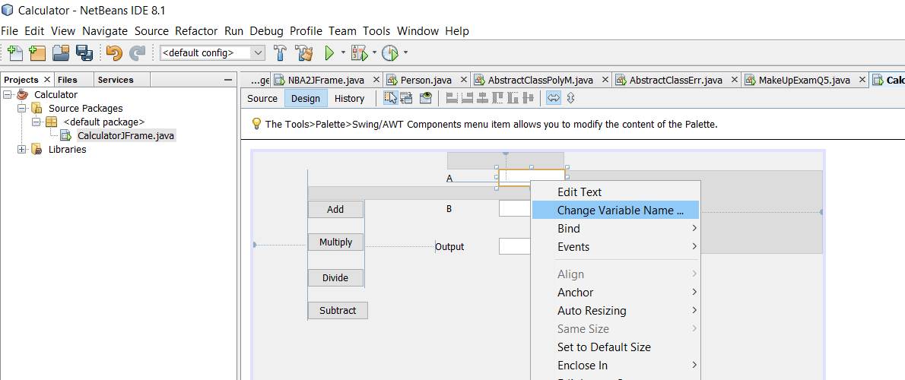
Changing Names of TextField Variables
Figure#5, Changing Names of TextField Variables

Slide 7
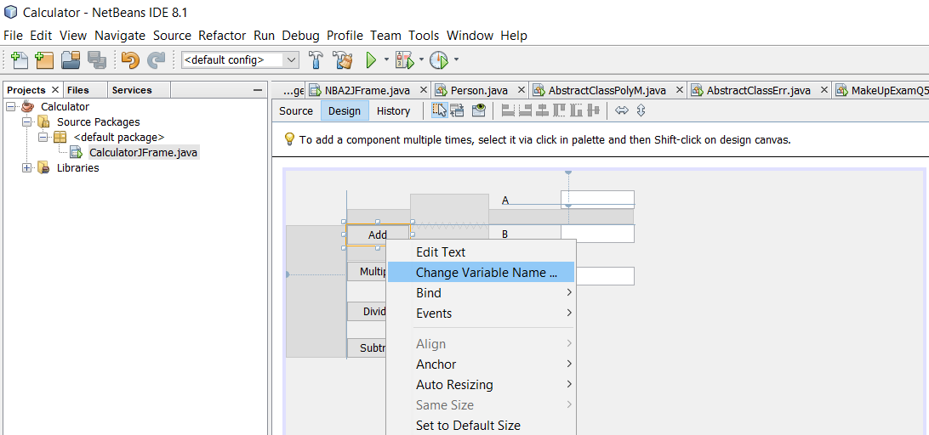
Changing Names of Button Variables
Changing Names of JButton Variables

Slide 8
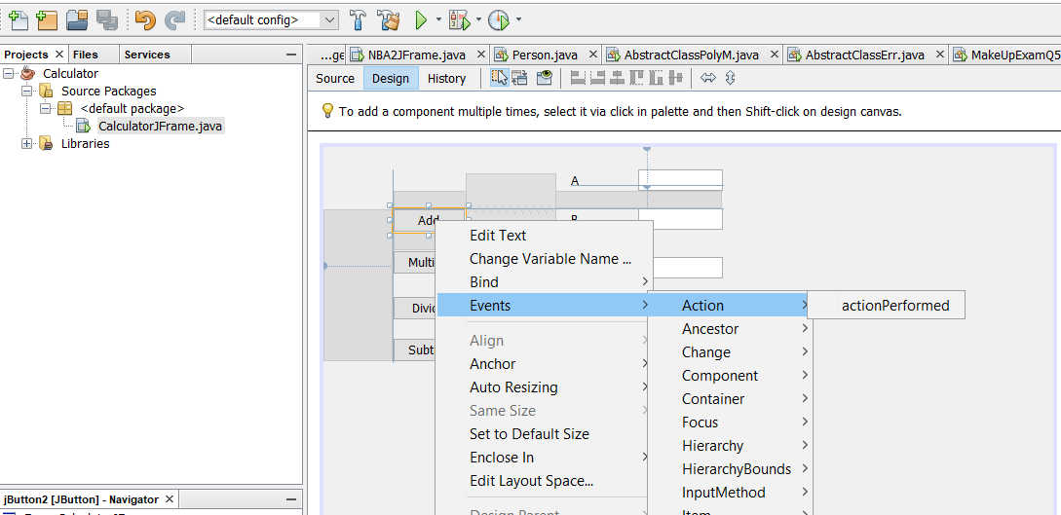
Creating Event Handlers for Buttons
Figure#7, Creating Event Handlers for Buttons

Slide 9
Declaring the Class
public class CalculatorJFrame extends javax.swing.JFrame {
}

Slide 10
Defining Button Event Handlers and Declaring Their Arguments
private void mAddBtnActionPerformed(java.awt.event.ActionEvent evt) {
// TODO add your handling code here:
}
private void mMulBtnActionPerformed(java.awt.event.ActionEvent evt) {
// TODO add your handling code here:
}
private void mDivBtnActionPerformed(java.awt.event.ActionEvent evt) {
// TODO add your handling code here:
}
private void mSubBtnActionPerformed(java.awt.event.ActionEvent evt) {
// TODO add your handling code here:
}

Slide 11
Defining Button Event Handlers and Declaring Their Arguments
private void mAddBtnActionPerformed(java.awt.event.ActionEvent evt) {
}
private void mMulBtnActionPerformed(java.awt.event.ActionEvent evt) {
}
private void mDivBtnActionPerformed(java.awt.event.ActionEvent evt) {
}
private void mSubBtnActionPerformed(java.awt.event.ActionEvent evt) {
}

Slide 12
private JButton mAddBtn;
private JButton mDivBtn;
private JButton mMulBtn;
private JButton mSubBtn;
private JTextField mTF_A;
private JTextField mTF_B;
private JTextField mTF_Output;

Slide 13
Writing the Code for Button Handlers
private void mAddBtnActionPerformed(java.awt.event.ActionEvent evt) {
// TODO add your handling code here:
String strA = mTF_A.getText();
String strB = mTF_B.getText();
int res = Integer.parseInt(strA) + Integer.parseInt(strB);
mTF_Output.setText(" " + res);
}
private void mMulBtnActionPerformed(java.awt.event.ActionEvent evt) {
// TODO add your handling code here:
String strA = mTF_A.getText();
String strB = mTF_B.getText();
mTF_Output.setText(" " +Integer.parseInt(strA) * Integer.parseInt(strB));
}
private void mDivBtnActionPerformed(java.awt.event.ActionEvent evt) {
// TODO add your handling code here:
String strA = mTF_A.getText();
String strB = mTF_B.getText();
mTF_Output.setText(" " +Integer.parseInt(strA) / Integer.parseInt(strB));
}

Slide 14
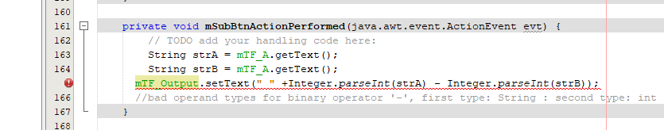
Discussion: Syntax Error in the Calculator Program
private void mSubBtnActionPerformed(java.awt.event.ActionEvent evt) {
// TODO add your handling code here:
String strA = mTF_A.getText();
String strB = mTF_A.getText();
mTF_Output.setText(" "+Integer.parseInt(strA) - Integer.parseInt(strB));
//bad operand types for binary operator '-', first type: String : second type: int
}
Figure#8, Systax Error in the Calculator Program

Slide 15
Why No Error In the Following Two Functions
private void mMulBtnActionPerformed(java.awt.event.ActionEvent evt) {
String strA = mTF_A.getText();
String strB = mTF_B.getText();
mTF_Output.setText(" " +Integer.parseInt(strA) * Integer.parseInt(strB));
}
private void mDivBtnActionPerformed(java.awt.event.ActionEvent evt) {
String strA = mTF_A.getText();
String strB = mTF_B.getText();
mTF_Output.setText(" " +Integer.parseInt(strA) / Integer.parseInt(strB));
}

Slide 16
Correct Way of Coding
public void actionPerformed(ActionEvent actionEvent)
{
int a=Integer.parseInt(textFieldA.getText());
int b=Integer.parseInt(textFieldB.getText());
textFieldC.setText(Integer.toString(a+b));
}

